Slide 1
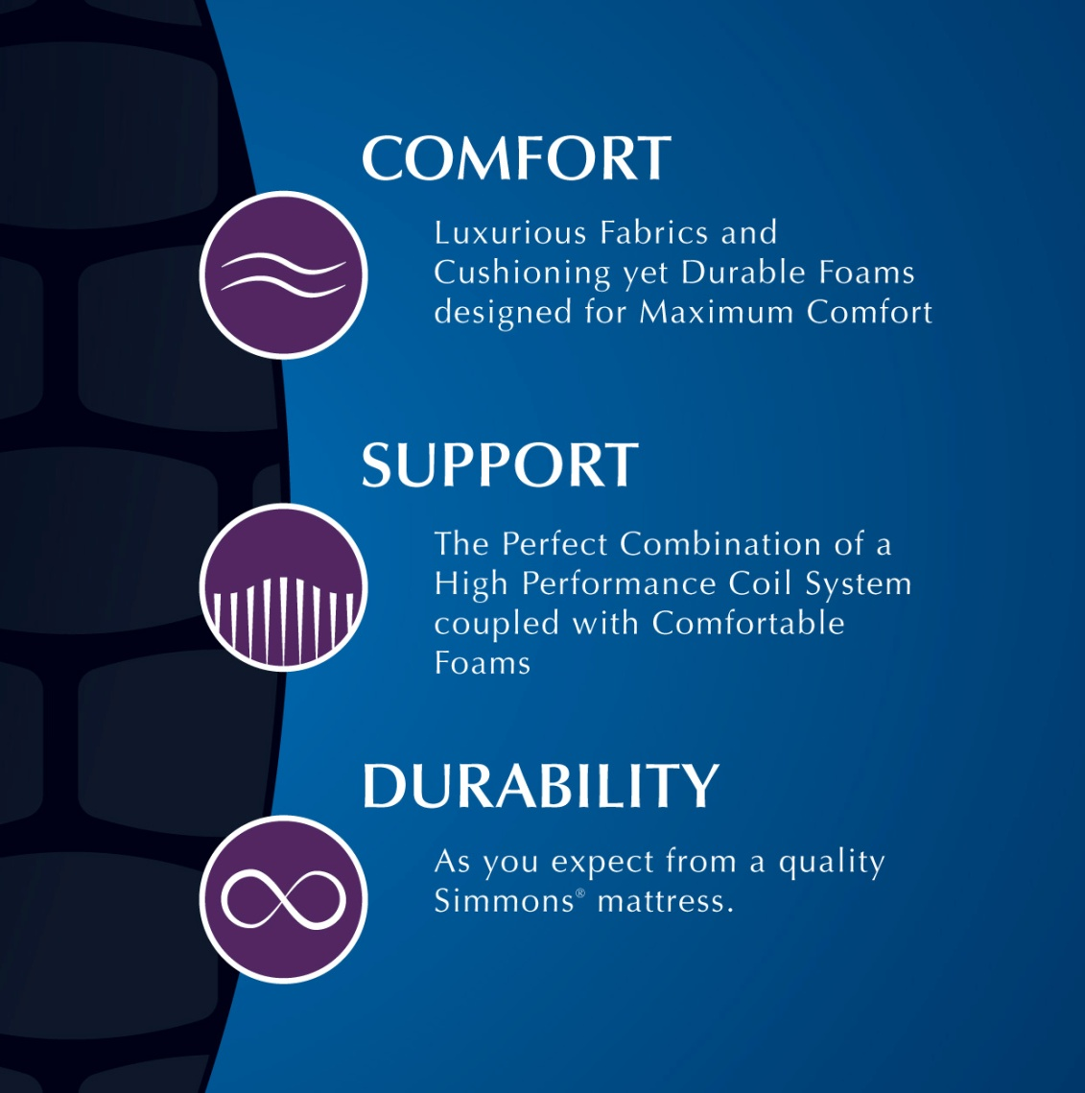
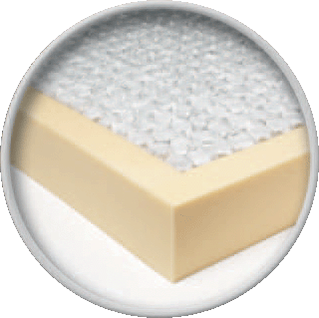
Balboa Terrace Firm
700 Series BeautySleep Individually “Pocketed” Coils™
Comfort Layers
FR Fiber
1 Layer 1” Firm Comfort Foam
1 Layer ½” Firm Comfort Foam
1 Layer ½“ Firm Comfort Foam
Coil Construction Insulators
Top – Quantum Lock Insulator
Bottom – 1 Layer Energy Foam™
Edge Support– 3” Foam Encasement w/ one row extra firm “seat edge” coils
Warranty – 10 Yr. Non-Prorated
Twin Set
Full Set
Queen Set
King Set
$000
$000
$000
$000
Reg $000
Reg $000
Reg $000
Reg $000

Slide 2
Lake St. Clair Plush
700 Series BeautySleep Individually “Pocketed” Coils™
Comfort Layers
FR Fiber
1 Layer 1” Plush “GelTouch” Foam
1 Layer 1” Plush Comfort Foam
2 Layers 1” Plush Comfort Foam
Coil Construction Insulators
Top – Quantum Lock Insulator
Bottom – 1 Layer Energy Foam™
Edge Support– 3” Foam Encasement w/ one row extra firm “seat edge” coils
Warranty – 10 Yr. Non-Prorated
Twin Set
Full Set
Queen Set
King Set
$000
$000
$000
$000
Reg $000
Reg $000
Reg $000
Reg $0000

Slide 3
Valley Lake Plush PillowTop
700 Series BeautySleep Individually “Pocketed” Coils™
Comfort Layers
FR Fiber
1 Layer 1” Plush “GelTouch” Foam
1 Layer 1” Plush Comfort Foam
1 Layers 2” Plush Comfort Foam
2 Layers ½” Firm comfort Foam
Coil Construction Insulators
Top – Quantum Lock Insulator
Bottom – 1 Layer Energy Foam™
Edge Support– 3” Foam Encasement w/ one row extra firm “seat edge” coils
Warranty – 10 Yr. Non-Prorated
Twin Set
Full Set
Queen Set
King Set
$000
$000
$000
$000

Slide 4





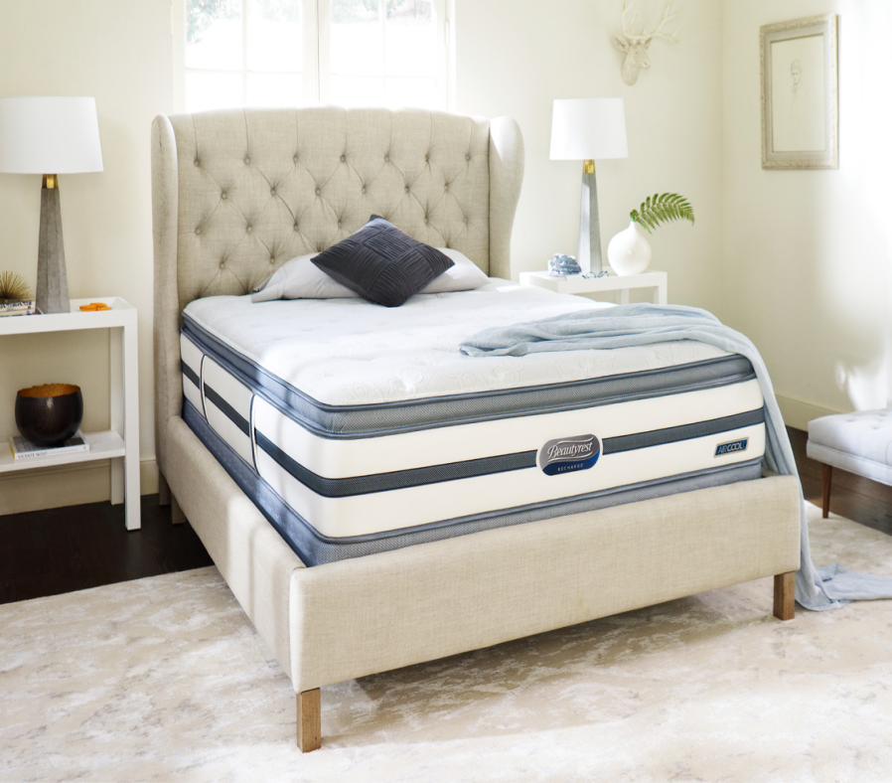

Built in the USA
Calgary™ Luxury Firm
Coil Unit..........800 Density Beautyrest® Pocketed Coil® Springs
………..13 ¾ Ga.
Edge Support.......Ventilated AirCool® BeautyEdge® Foam
Encasement with QuantumLock™
Quilt.....................1” AirCool® Foam
.....................1” AirCool® Foam
Upholstery...........1/2” GelTouch™
..........1/2” EnergyFoam™
AirCool® Design ......AirCool® Mesh Border
......AirCool® Foam
......AirCool® BeautyEdge® Foam Encasement
Coil Support.................... EnergyFoam™
Foundation.......................Triton® Foundation
......................NuFlex™ Foundation compatible
Warranty.......................... 20 Year Limited Warranty
EXPERIENCE RECHARGING SLEEP
Beautyrest® Pocketed Coil® Technology provides conforming back support
AirCool® and Gel Foams provide pressure relief, promote freedom of movement and provide a comfortable sleeping temperature
Twin Set
Full Set
Queen Set
King Set
$000
$000
$000
$000
w/ NuFlex $0000
w/ NuFlex $0000

Slide 5
Calgary™ Plush
Built in the USA
Coil Unit..........800 Density Beautyrest® Pocketed Coil® Springs
………..15 ½ Ga.
Edge Support.......Ventilated AirCool® BeautyEdge® Foam
Encasement with QuantumLock™
Quilt.....................1” AirCool® Foam
.....................1” AirCool® Foam
Upholstery...........1/2” GelTouch™
..........1/2” EnergyFoam™
AirCool® Design ......AirCool® Mesh Border
......AirCool® Foam
......AirCool® BeautyEdge® Foam Encasement
Coil Support.................... EnergyFoam™
Foundation.......................Triton® Foundation
......................NuFlex™ Foundation compatible
Warranty.......................... 20 Year Limited Warranty
EXPERIENCE RECHARGING SLEEP
Beautyrest® Pocketed Coil® Technology provides conforming back support
AirCool® and Gel Foams provide pressure relief, promote freedom of movement and provide a comfortable sleeping temperature
Twin Set
Full Set
Queen Set
King Set
$000
$000
$000
$000
w/ NuFlex $0000
w/ NuFlex $0000

Slide 6
Built in the USA
Calgary™ Plush Pillow Top
Coil Unit..........800 Density Beautyrest® Pocketed Coil® Springs
………..15 ½ Ga.
Edge Support.......Ventilated AirCool® BeautyEdge® Foam
Encasement with QuantumLock™
Quilt.....................1” AirCool® Foam
.....................1” AirCool® Foam
Upholstery...........2” Plush Comfort Foam
………..1/2” GelTouch™
..........1/2” EnergyFoam™
AirCool® Design ......AirCool® Mesh Border
......AirCool® Foam
......AirCool® BeautyEdge® Foam Encasement
Coil Support.................... EnergyFoam™
Foundation.......................Triton® Foundation
......................NuFlex™ Foundation compatible
Warranty………..20 Year Limited Warranty
EXPERIENCE RECHARGING SLEEP
Beautyrest® Pocketed Coil® Technology provides conforming back support
AirCool® and Gel Foams provide pressure relief, promote freedom of movement and provide a comfortable sleeping temperature
Twin Set
Full Set
Queen Set
King Set
$000
$000
$000
$000
w/ NuFlex $0000
w/ NuFlex $0000

Slide 7
Built in the USA
Coil Unit..........800 Density Beautyrest® Pocketed Coil® Springs
………..13 ¼ Ga.
Edge Support.......Ventilated AirCool® BeautyEdge® Foam
Encasement with QuantumLock™
Quilt.....................1” AirCool® Foam
.....................1” AirCool® Foam
Upholstery........... 2” Plush Comfort Foam
…........1/2” GelTouch™
………...1/2” AirCool™ Memory foam
...........1/2” Energy Foam™
AirCool® Design ......AirCool® Mesh Border
......AirCool® Foam
......AirCool® BeautyEdge® Foam Encasement
Coil Support.................... EnergyFoam™
Foundation.......................Triton® Foundation
......................NuFlex™ Foundation compatible
Warranty………..20 Year Limited Warranty
Dresden Villa™ Luxury Firm Pillow Top
EXPERIENCE RECHARGING SLEEP
Beautyrest® Pocketed Coil® Technology provides conforming back support
AirCool® and Gel Foams provide pressure relief, promote freedom of movement and provide a comfortable sleeping temperature
Twin Set
Full Set
Queen Set
King Set
$000
$000
$000
$000
w/ NuFlex $0000
w/ NuFlex $0000

Slide 8

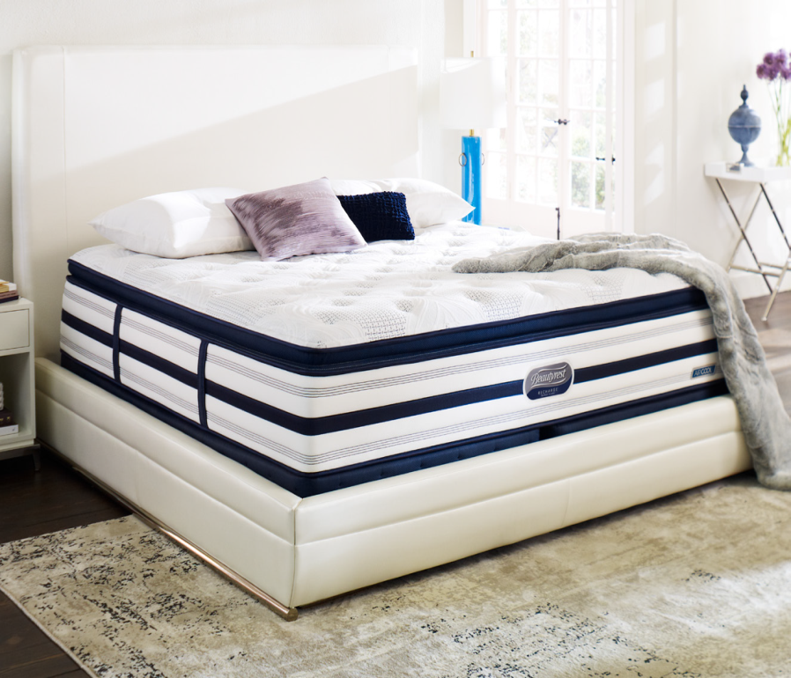
Built in the USA
Longs Peak™ Firm
Coil Unit.........1000 Density Beautyrest® Pocketed Coil® Springs
……....13 ¼ Ga.
Edge Support.......Ventilated AirCool® BeautyEdge® Foam
Encasement with QuantumLock™
Quilt.....................1 ” AirFeel® Foam
.....................1” Luxury Firm Comfort Foam
Upholstery........... ½” TruTemp™ Gel
……….. ½” AirCool™ Memory foam
...........1/2” Energy Foam™
AirCool® Design ......AirCool® Mesh Border
......AirCool® Foam
......AirCool® BeautyEdge® Foam Encasement
Coil Support.................... EnergyFoam™
Foundation.......................Triton® Foundation
......................NuFlex™ Foundation compatible
Warranty………..25 Year Limited Warranty
EXPERIENCE RECHARGING SLEEP
Beautyrest® Pocketed Coil® Technology provides conforming back support
AirCool® and Gel Foams provide pressure relief, promote freedom of movement and provide a comfortable sleeping temperature
AirCool® and Gel Foams provide pressure relief, promote freedom of movement and provide a comfortable sleeping temperature
Twin Set
Full Set
Queen Set
King Set
$000
$000
$000
$000
TruTemp™ Gel absorbs, stores, and releases excess warmth to help keep you in a comfortable temperature zone
w/ NuFlex $0000
w/ NuFlex $0000

Slide 9
Built in the USA
Longs Peak™ Plush
Coil Unit..........1000 Density Beautyrest® Pocketed Coil® Springs
………..15 ½ Ga.
Edge Support.......Ventilated AirCool® BeautyEdge® Foam
Encasement with QuantumLock™
Quilt.....................1 ¼” AirFeel® Foam
.....................1” AirCool™ Foam
Upholstery........... ½” TruTemp™ Gel
………...2” AirCool™ Memory foam
AirCool® Design ......AirCool® Mesh Border
......AirCool® Foam
......AirCool® BeautyEdge® Foam Encasement
Coil Support.................... EnergyFoam™
Foundation.......................Triton® Foundation
......................NuFlex™ Foundation compatible
Warranty………..25 Year Limited Warranty
EXPERIENCE RECHARGING SLEEP
Beautyrest® Pocketed Coil® Technology provides conforming back support
AirCool® and Gel Foams provide pressure relief, promote freedom of movement and provide a comfortable sleeping temperature
AirCool® and Gel Foams provide pressure relief, promote freedom of movement and provide a comfortable sleeping temperature
Twin Set
Full Set
Queen Set
King Set
$000
$000
$000
$000
TruTemp™ Gel absorbs, stores, and releases excess warmth to help keep you in a comfortable temperature zone
w/ NuFlex $0000
w/ NuFlex $0000

Slide 10
Built in the USA
Longs Peak™ Plush Pillow Top
Coil Unit..........1000 Density Beautyrest® Pocketed Coil® Springs
………..15 ½ Ga.
Edge Support.......Ventilated AirCool® BeautyEdge® Foam
Encasement with QuantumLock™
Quilt.....................1 ¼” AirFeel® Foam
......................1” AirCool™ Foam
Deck…………………..2” AirCool™ Memory Foam
Upholstery........... ½” TruTemp™ Gel
………...1 ½” AirCool™ Memory foam
AirCool® Design ......AirCool® Mesh Border
......AirCool® Foam
......AirCool® BeautyEdge® Foam Encasement
Coil Support.................... EnergyFoam™
Foundation.......................Triton® Foundation
......................NuFlex™ Foundation compatible
Warranty…………..25 Year Limited Warranty
EXPERIENCE RECHARGING SLEEP
Beautyrest® Pocketed Coil® Technology provides conforming back support
AirCool® and Gel Foams provide pressure relief, promote freedom of movement and provide a comfortable sleeping temperature
AirCool® and Gel Foams provide pressure relief, promote freedom of movement and provide a comfortable sleeping temperature
Twin Set
Full Set
Queen Set
King Set
$000
$000
$000
$000
TruTemp™ Gel absorbs, stores, and releases excess warmth to help keep you in a comfortable temperature zone
w/ NuFlex $0000
w/ NuFlex $0000

